Slide 2
Natural acceptance of human values means what is naturally acceptable to humans without hesitation or any objection.

Slide 3
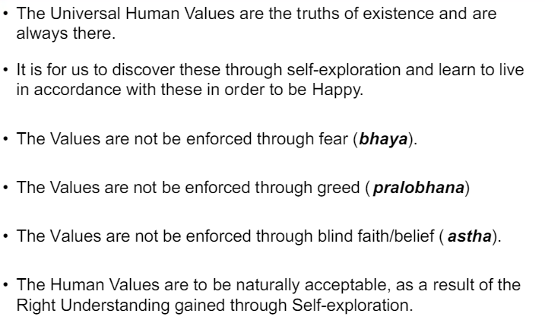
U 5 Natural acceptance of human values

Slide 4
It is right to say that we naturally accept Human Values in the light of our understanding of Harmony and Co-Existence.
Every Human be Every person naturally expects goodness to happen. We all are waiting for goodness to happen. Every one naturally expects to be purposeful and successful.

Slide 5
Human values are realized by understanding of Jeevan, understanding of existence as co-existence, and by natural acceptance of humane conduct.
Understanding Jeevan and understanding Existence are essentialfor becoming wise.

Slide 6
Natural acceptance is process to understand ourselves first. Natural acceptance implies unconditional and total acceptance of the self, people and environment. It also refers to the absence of any exception from others. In other words, Natural acceptance is way to accept the good things naturally.

Slide 7
For example our natural acceptance for trust and respect does not change with age. It does not depend on the place. Whatever we have accepted, in our life, at any time of our age, does not change, even if we move from one place to another one.
Natural acceptance is the same for all of us.

Slide 8
How can we verify proposals on the basis of our natural acceptance? Explain with example What do you mean by your natural acceptance? Is it innate, invariant and universal? Explain(UPTU 2011 — 12). "Natural acceptance is innate, invariant and universal." Explain this statement with an example (MTU 2011 — 12)
Natural acceptance implies unconditional and total acceptance of the self, people and environment also refers to the absence of any exception from others. Once we fully and truly commit ourselves to natural acceptance, we feel a holistic sense of inner harmony, peacefulness and fulfilment.

Slide 9
We can easily verify proposals in the characteristics of natural acceptance mentioned below:
Natural acceptance does not change with time. It remains invariant with time. For example natural acceptance for trust and respect does not change with age.
b. It does not depend on the place. Whatever we have accepted, in our life, at any time of our age does not change, even if we move from one place to another one.
Natural acceptance is the same for all of us

Slide 10
Characteristics of Natural Acceptance
Natural acceptance does not change with time.
Natural Acceptance does not depend on the place.
Natural Acceptance does not depend on our beliefs or past conditioning.
This natural acceptance is ‘constantly there’, something we can refer to.
Natural acceptance is the same for all of us: it is part and parcel of every human being, it is part of humanness.

Slide 11
Ethical Human Conduct
The right understanding gained through self-exploration also enables us to identify the definitiveness of human conduct which may also be called ethical human conduct.
It is the same for all human beings. So we are also able to understand the universality of ethical human conduct which aligns with universal human values.

Slide 12
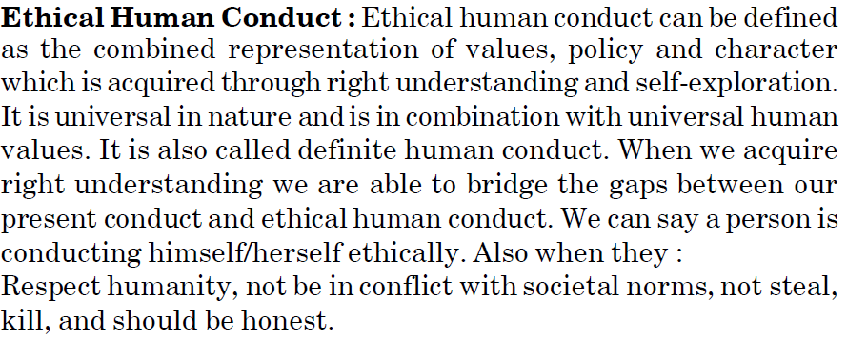

Slide 13
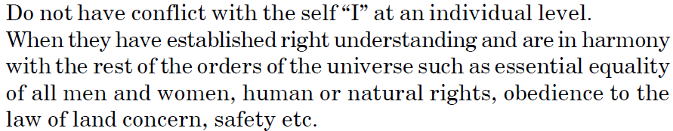

Slide 14
Definitiveness of Ethical Human Conduct
The definitiveness of Ethical Human Conduct is in terms of values, policies and character.
Ethical conduct is the foundation of professional ethics.
Depends on three things, namely- 1) Values 2) Policies 3) Character Values- Values are a part of our ethical conduct.

Slide 15
What is ethical human conduct? OR How does right understanding provide the basis for ethical human conduct?
The right understanding gained through self-exploration enables us to identify the definitiveness of human conduct which may also be called the ethical human conduct.
It is the same for all human beings. So we are also able to understand the universality of ethical human conduct which is in consonance with the universal human values.
Unless we have the right understanding, we are not able to identify the definitiveness of ethical human conduct.

Slide 16
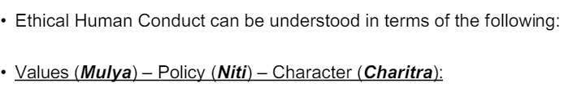

Slide 17
What do you mean by definitiveness of ethical human conduct? How can it be ensured?
The right understanding gained through self-exploration also enables us to identify the definitiveness of human conduct which may also be called the ethical human conduct.
It is the same for all human beings. So we are also able to understand the universality of ethical human conduct which is in consonance with the universal human values.

Slide 18
Each one of us wants to have a definite conduct but presently we may not be able to ensure that. This is because we are presently living on the basis of our pre-conditionings or assumptions which are not in consonance with the truth or the right understanding.

Slide 19
But, this situation neither gives satisfaction to us not to others. We do see the human beings struggling to find out what the right conduct is and in the process, exhibiting a wide variety of attributes.
We also see people debating endlessly about what they consider to be ethical. But unless we have the right understanding, we are not able to identify the definitiveness of ethical human conduct

Slide 20
It can be understood in terms of the following:
1. Values (Mulya) : Competence of living in accordance with universal human values or the participation of a unit in the larger order- its natural characteristics or svabhava is known as values. Values are a part of our ethical conduct

Slide 21
. 2. Policy (Niti) : policy is the decision (plan, program, implementation, results, evaluation) about the enrichment, protection and right utilization of the resources (self, body and wealth - mana, tana and dhana).
3. Character (Charitra) : The definiteness of my desire, thought and selection gives definiteness to my living.
Definitiveness of character is the outcome of the definiteness of my behaviour and work.

Slide 22
Humanistic Education
Humanistic education is a humane approach to education
The ultimate purpose of humanistic approach in education is the learning process that was started and is intended for the benefit of humanizing mankind. Humanizing humans, is to achieve self-actualization, self-understanding, and self-realization people to learn optimally

Slide 23
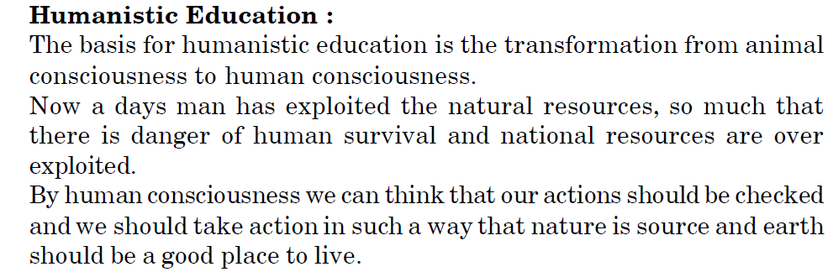

Slide 24
Humanistic education will incorporate appropriate integration of values and skills so that human beings are able to understand their physical needs correctly and adopt suitable techniques and production systems to cater to these needs in an eco-friendly and people friendly manner.

Slide 25
Humanistic education (also called person-centered education) is an approach to education based on the work of humanistic psychologists.
Humanistic education leads to human conduct, human constitution, universal human order, and in turn, universal human order ensures humanistic education for the next generation.

Slide 26
The humanistic education will facilitate the process of self exploration which will lead to continuous self evolution of human beings.
It will also enable the realization of one’s innateness (svatva) as well as the universality and definitiveness of ethical human conduct

Slide 27
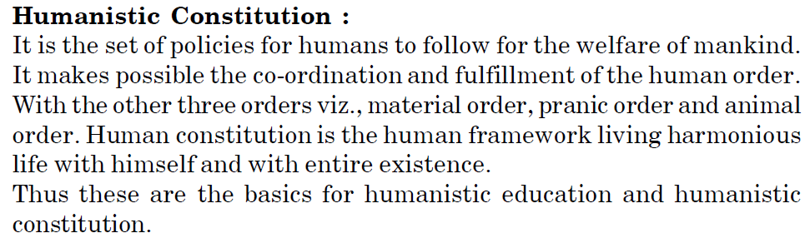
What is Humanistic constitution

Slide 28
Humanistic universal order
Universal human order (sarvabhatima vyavastha) is a feeling of being related to every unit including human beings and other entities of nature. Having understood the comprehensive human goal, we are able to be in harmony not only with human beings, but also with the rest of the nature.-

Slide 29
Humanistic Constitution
The humanistic constitution mentions the set of rules that human beings must and should follow.
In addition, the right understanding also provides us the basis for a humanistic constitution which is essential to provide clear guidelines and policy framework conducive to the development of an un-fragmented human society and a universal human order.

Slide 30
Working towards the comprehensive human goal and developing the competence for ethical human conduct will be among the salient directive principles of a humanistic constitution.
It will safeguard the social justice in true sense

Slide 31
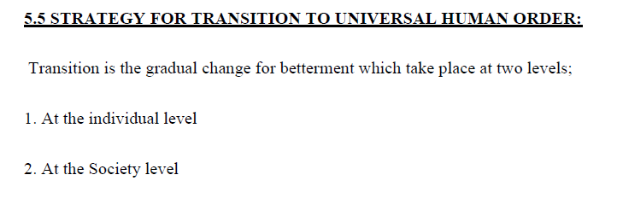

Slide 32
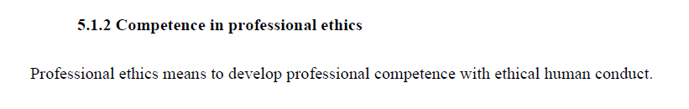

Slide 33
